Slide 1

Key Indicators of Heart Disease
By Suchitra Subramani
Notes:
The purpose is

Slide 2



Introduction
Behavioral Risk Factor Surveillance System
CDC conducts an annual health-related telephone survey to get information about health conditions and risk behaviors through their BRFSS.
Heart Disease is the leading cause of death in the United States, almost 7 million a year.
Established key indicators of heart disease includes High Blood Pressure, High Cholesterol and Smoking.
Notes:
Established in 1984 in 15 states across United States, BRFSS has now expanded to all 50 states.
Latest BRFSS data is from annual survey conducted in 2020.
Approximately, 400,000 participants and 200 questions.

Slide 3
Project Details
Physicians/ Health care providers constantly looking for more indicators that will accurately predict heart disease.
Key Indicators that I am interested includes, Basal Mass Index (BMI) and Diabetes.
Among those that have had heart disease we will study the role played by BMI and Diabetes and if monitoring these variables will help progression/prevention of Heart Disease.

Slide 4
Potential Value
Physicians and healthcare providers that are constantly striving to improve the cardiovascular health of the population.
Tech companies that are constantly innovating and investing heavily in wearables, are monitoring resting heart rate, cardiovascular output during exercise, skipped heart beats, step counting and many more in the pipeline including glucose monitoring.
Notes:
1. Over time BRFSS has become a powerful tool for targeting and building health activities. As a result over time BRFSS users have demanded increasing more questions on this survey.
2. Tech companies are investing heavily
3. Also requests to the BRFSS to coach other nations to collect similar data

Slide 5

Details on the Dataset
Original data from CDC, very large.
Smaller dataset, a subset of variables, from Kaggle.
319K respondents or rows of data
19 columns, 18 variable and 1 ID number
Focus on BMI, Heart Disease, Diabetes and Age Category
Notes:
Latest Survey 2020

Slide 6
More Details on the Dataset
Column/ Variable | Type
BMI | Quantitative
PhysicalHealth | Quantitative
MentalHealth | Quantitative
SleepTime | Quantitative
AgeCategory | Categorical Ordinal
GenHealth | Categorical Ordinal
Race | Categorical Nominal
Diabetic | Categorical Nominal
HeartDisease | Categorical Boolean
Smoking | Categorical Boolean
AlcoholDrinking | Categorical Boolean
Stroke | Categorical Boolean
DiffWalking | Categorical Boolean
Sex | Categorical Boolean
PhysicalActivity | Categorical Boolean
Asthma | Categorical Boolean
KidneyDisease | Categorical Boolean
SkinCancer | Categorical Boolean
3604 unique values ranging from 12.02 to 94.85
14 age categories
(18-24, 25-29,30-34, 35-39, 40-44, 45-49, 50-54, 55-59, 60-64,
65-69, 70-74, 75-79, 80 and older)
Yes, No, No (Borderline), Yes (Gestational)
Yes, No
Notes:
Eventually for the purpose of this analysis project, will eliminate No Boderline and Gestational diabetes

Slide 7
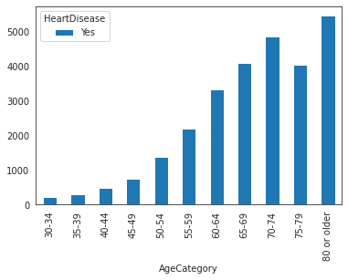
Questions
BMI
Among the respondents with and without heart disease, is there any difference in the BMI between these two groups.
Diabetes
Among these respondents, is there any relationship between heart disease and diabetes.
Notes:
Address the age group here.
The goal is to find key indicators and keep monitoring them along with the established key indicators in order to prevent Heart Disease.
There a trend that is going up starting at 40 years and becomes clear at 45 years of age. Any monitoring is best started at around 30 years of age, monitoring BMI and diabetes among adults starting age 30.

Slide 8
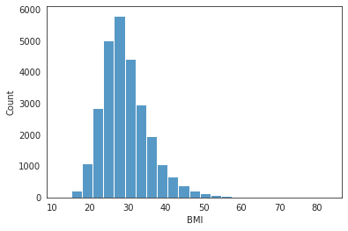
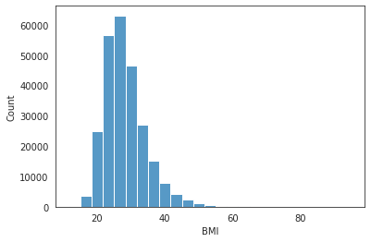
Hypothesis 1
Ho: There is no significant difference in BMI between people with heart disease and without heart disease over the age of 30. Ha: There is a significant difference in BMI between people with heart disease and without heart disease over the age of 30.
t-test for the mean of two independent variables
p-value = 1.62e-125
p-value < our alpha of 0.05, we reject Ho as data provides evidence to suggest so.
This means that there is a significant difference between the BMI of those that have heart disease and those that have not from the age of 30 and above.
BMI of people with Heart Disease
BMI of people without Heart Disease
Notes:
This analysis DOES NOT tell us if an increase in BMI is a cause for Heart Disease, but it could be a key indicator that needs to be monitored to either prevent the progression of heart disease or prevent heart disease in healthy population.
Sample size of yes heart disease: 27110
Sample size of No heart disease: 254666

Slide 9
Hypothesis 2
Ho: There is no correlation between Heart Disease and Diabetes among population above the age of 30.
Ha: There is a greater incidence of Heart Disease among Diabetic population above the age of 30.
For this analysis-
Group 1: Diabetic/ Not Diabetic (eliminated the No, borderline and the diabetes during pregnancy groups).
Group 2: Heart Disease Yes/ No
Both these groups carry Categorical Values, we look for correlation using chi squared test for independence.
The p-value: 0.0, since p-value is low we reject the Ho that there is no correlation between Heart Disease and Diabetes.
Cramer’s V to test the strength of correlation between two categorical variables involved in chi-squared test.
Cramer’s V = 0.462 (ranges from 0 to 1), implies moderately positive correlation.
Seems to be some correlation between Heart Disease and Diabetes.
Important! Correlation does not imply causation.
Notes:
Cramér’s V is an effect size measurement for the chi-square test of independence. It measures how strongly two categorical fields are associated.

Slide 10
Key Insights
Statistically significant difference observed between the BMI among those that have/do not have heart disease in this dataset.
Correlation between higher glucose levels and heart disease observed in this dataset.
The population of United States is 320 million and this dataset has roughly 0.1% of the population.
Large sample size to make observations but not enough to draw causation and change standard of care.
Annual survey, so would be interesting to see how how these trends continue or change with time.

Slide 11
Recommendations
Other interesting variables to track are sleep time, physical activity, asthma, differences in BMI across various races and genders.
Tech innovation in wearables and post COVID advancements in telemedicine can provide the individual and their physician more power to track some of these variables from as early as 30 years to keep the cardiovascular health in check and reduce the number of adverse events.
In time, these datasets and analysis will help improve lifestyle and reduce the deaths due to Heart Disease
Notes:
Something simple that can be measured as opposed to High Cholesterol

Slide 12

Thank You!
Questions?

